Slide 1
Certification Management system PREPARED FOR SFDC Training Capgemini Technology Services MENTOR: Rahul Vikash PREPARED BY Voleti Venkatesh

Slide 2
Abstract: The Certification Management App is a Salesforce based management App. It basically issues certifications to employees who can request it through App User via Email. The App Admin creates certifications and Vouchers and App User’s Request for Certification is approved by App Admin and a Voucher is automatically assigned to Certification Request once it is Approved. Scope – Features of system Following is the functionality provided by the system: There are two categories of people who would access the system: App User and App Admin. 1.App User : Can Create, Edit and Delete Employees Can Create, Edit and Delete Certification Requests Can view Certifications and Vouchers Can view and Edit Reports and Dashboards Can Update status of Certification request to Pass or Fail.

Slide 3
2.App Admin: Can Create, Edit and Delete Certifications. Can Create, Edit and Delete Vouchers. Can view Certifications Requests and Employees Can view and Edit Reports and Dashboards Can Update status of Certification request to Approved or Rejected. As we mentioned the Scopes of the App, The Out bounds of Scope include: The Employees login isn’t included in the Application The Employees can share their details and can only see their Approval in mail. Third Party applications like email integrations.

Slide 4
Employees Object: The Employees object is used to have the records related to Employees. Fields: Emp Id Emp Name Employee Email Primary Skill Secondary Skill Experience Comments Certification Object: The certifications object is used to have records related to Certifications. Fields: Cert Id Cert Name Comments

Slide 5
Voucher Object: The Voucher object contains the Voucher ID and other related fields to Vouchers. Fields: Voucher Id Voucher Cost Certification-Lookup Relationship Validity-Date Active- Boolean Comments Certification Request Object: The certification Request Object contains the Vital Relationships with Employees, Vouchers and certifications. Fields: Certification - Master-Detail Relationship Employees – Master-Detail Relationship Voucher (lookup) Due Date Status (Picklist) Draft, Approved Rejected Comments

Slide 6
Routing – Process Builder and Approval Process: Process Builder It contains a process Builder which contains different stages When the status is set to draft it initiates approval process by sending conformation email to employee that the request is submitted. Based on Approval ,if the status is Approved the employee and App user gets notified that the request is approved. If status is rejected, the comments will be posted along with mail to Employee and App User. Once, status is approved a voucher is assigned and status is changed to Assigned. Approval Process: Once the request is submitted and status is draft , an approval process is initiated. The Approval is done by App Admin based on details of employee. If he/she is approved, the status is changed to Approved as a field update. If he/she rejects, the status is changed to rejected as a field Update.

Slide 7
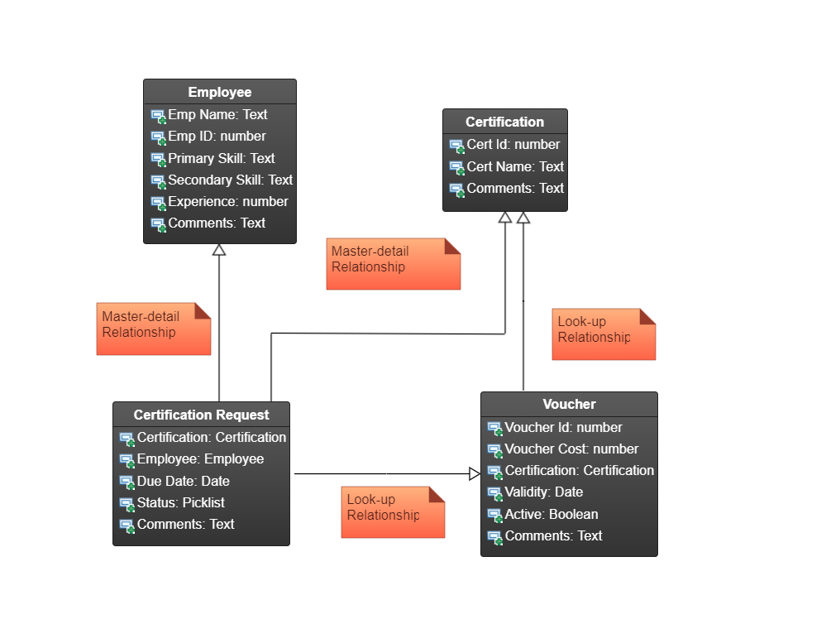
Class Diagram:

Slide 8
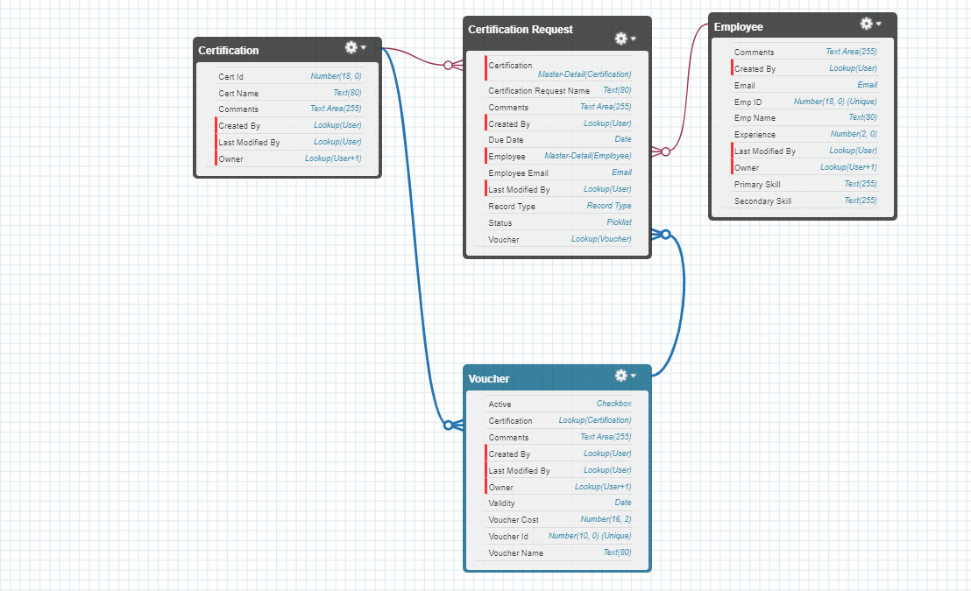
Entity Relationship Diagram:

Slide 9
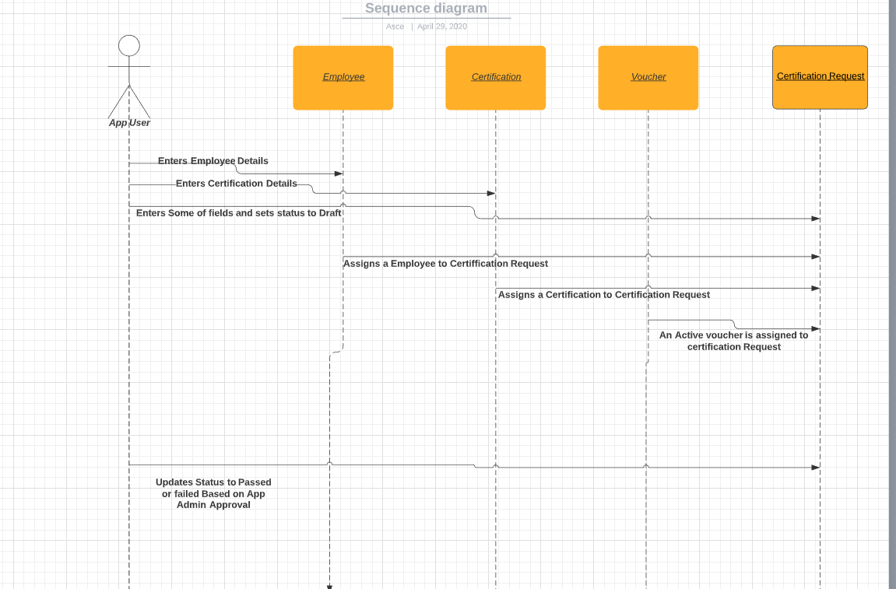
Sequence Diagram of App User:

Slide 10
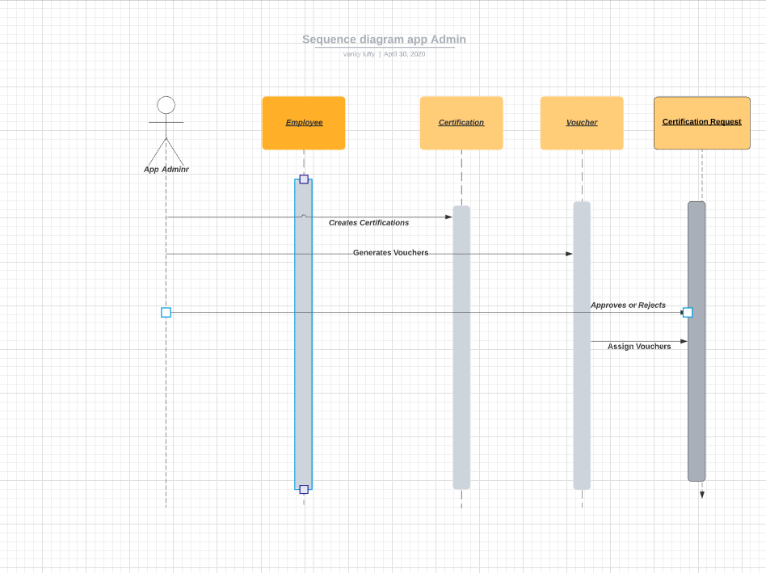
Sequence Diagram of App Admin:

Slide 11
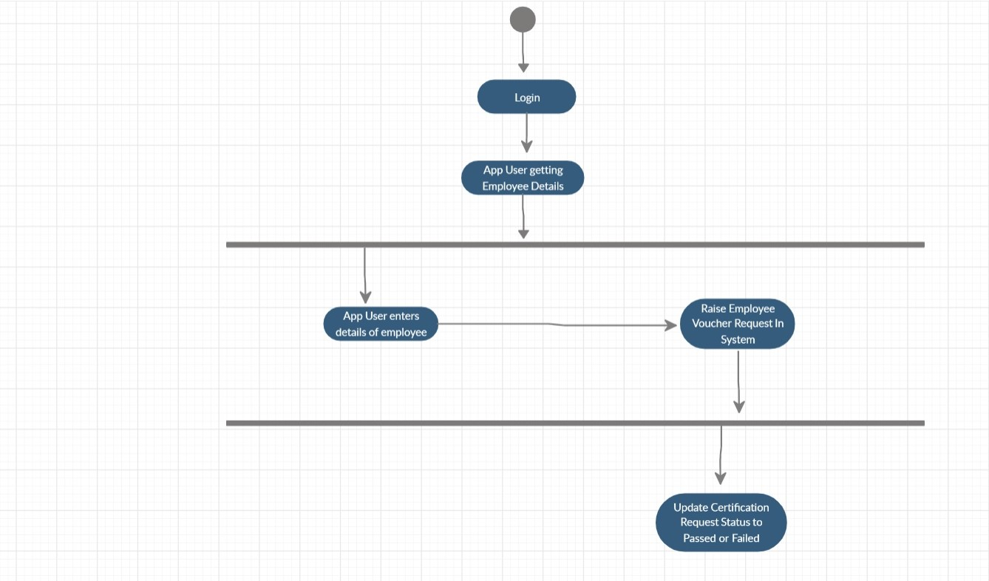
Activity Diagram for App user:

Slide 12
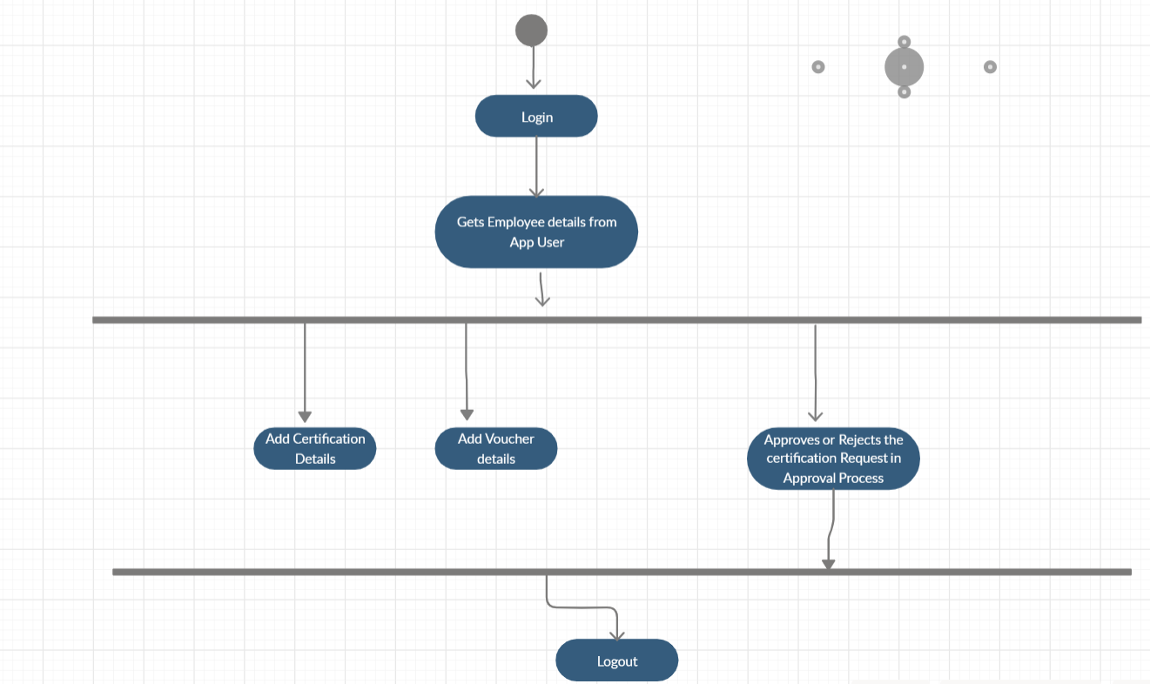
Activity Diagram for App Admin:

Slide 13
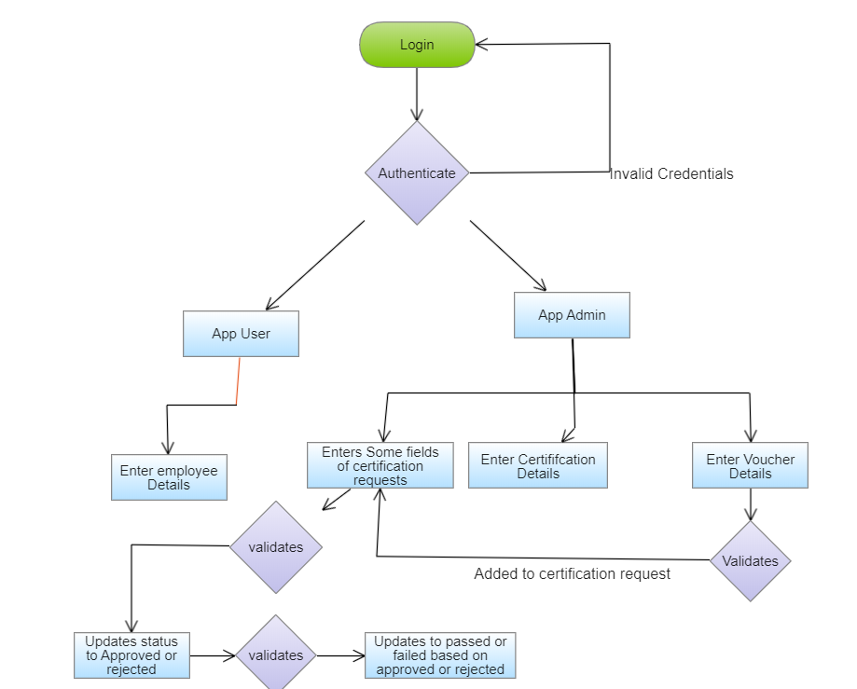
Flow Chart:

Slide 14
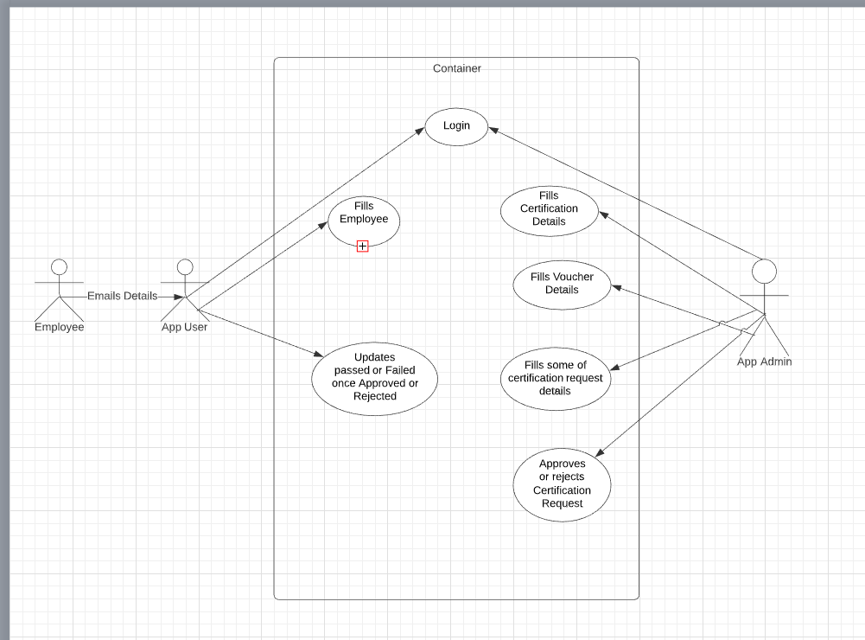
Use Case Diagram:

Slide 15
Validations – Rules and triggers Rules: The rules here include for the inputs and validations that are to be followed in order to function App smoothly. The rules include: The Employee ID must be unique Experience must be in years completed Certification Name must be unique Due Date must not be less than Today. Status should always be Draft at the beginning. Once an employee has requested for certification, he cannot make any more requests - Same certification and Voucher cannot be used over again, if already used. Voucher Name must be unique and 10 chars long. Validity should be greater than today. A Voucher should be Active for it to be applied. If a request has been approved and has no voucher, but a voucher is available, then it should be automatically applied. Triggers: The Apex Triggers help in managing the validations and for proper functioning of App. I used 3 Triggers. 1.Checking Duplicates (Certification Request) : This trigger helps us in checking if a Certification request is not being made with the same set of Certification and Voucher details, which were used previously (if any). 2.Employee Duplicate (Certification Request) This trigger helps us in checking if a Certification request is being made with an Employee who already has a request pending or approved.

Slide 16
3.Auto Voucher (Certification Request) This trigger comes into run only when a Request Status has been set to Approved without any voucher for that Request. If a voucher is available in the Voucher object for that certification (unused), then only this trigger will help in applying that voucher to the appropriate Request and deactivate that voucher. Assumptions: The Assumptions include: Employee sends his information through Email to App User. The Employee is not a type of User in Salesforce App Admin cannot add App Users. Employee cannot modify his details in salesforce. Employee request status is passed through Email Certification request is assigned to approved by the Approval Process, but not when a voucher has been applied. Reports and Dashboards have the time frequency set to the Current Financial Year, and this can be changed be the viewer accordingly, to fit his timeline.

Slide 17
Application Flow: App Admin creates Certifications and Vouchers. Employees can request to App User through Email. App User adds Employees details and raises certification Requests. The status of request is draft initially and is sent for approval. App Admin Approves or Rejects the request and email notification is sent to App User and employee. Once it is Approved and no voucher is added to request, a voucher is automatically assigned to it which is active. Employee sends the status of his request passed to him from App Admin to App User App User modifies the status of request to Passed or failed. The employee cannot apply for certification again once he is passed or failed. This is the flow of certification management Application.

Slide 18
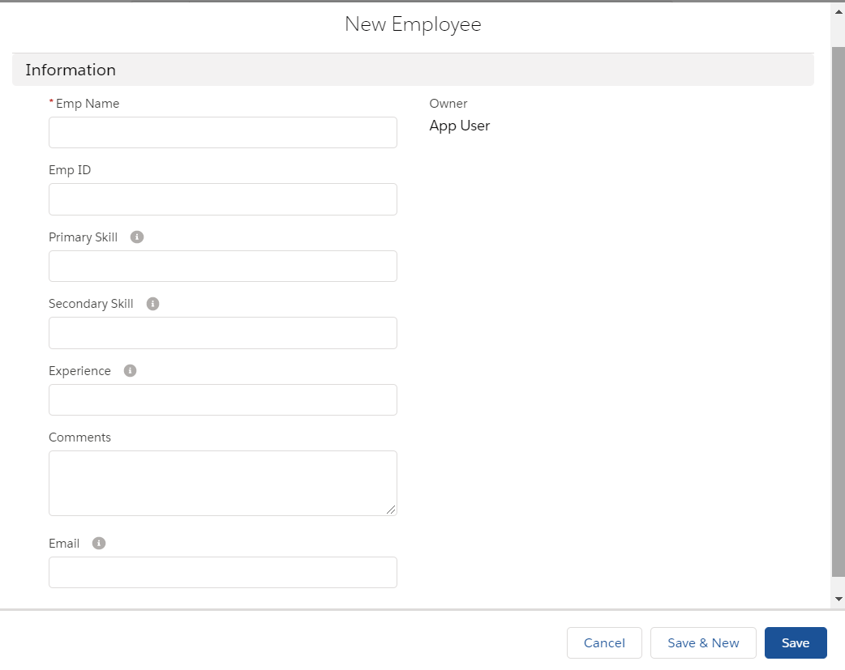
New Employees fill Out Form:

Slide 19
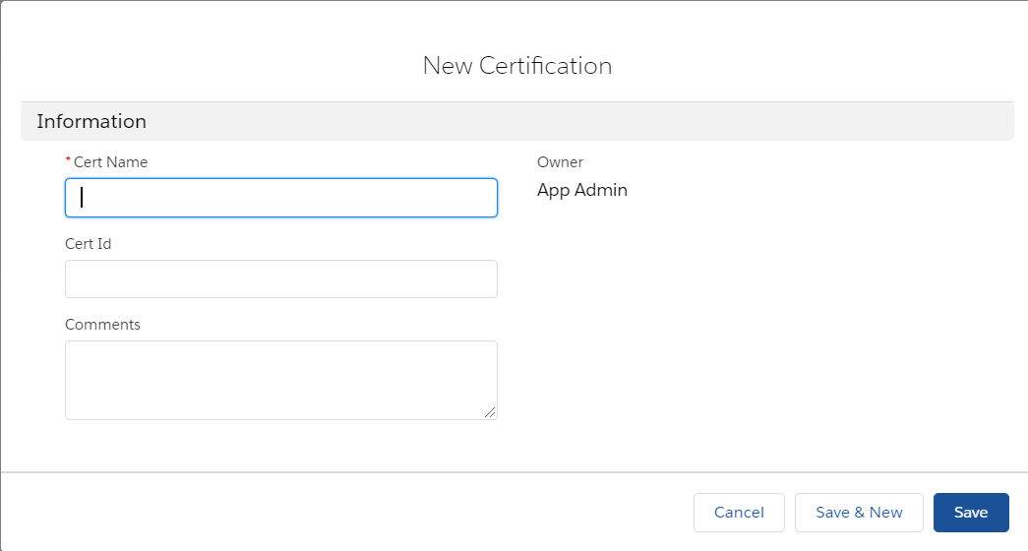
New Certification fill Out Form:

Slide 20
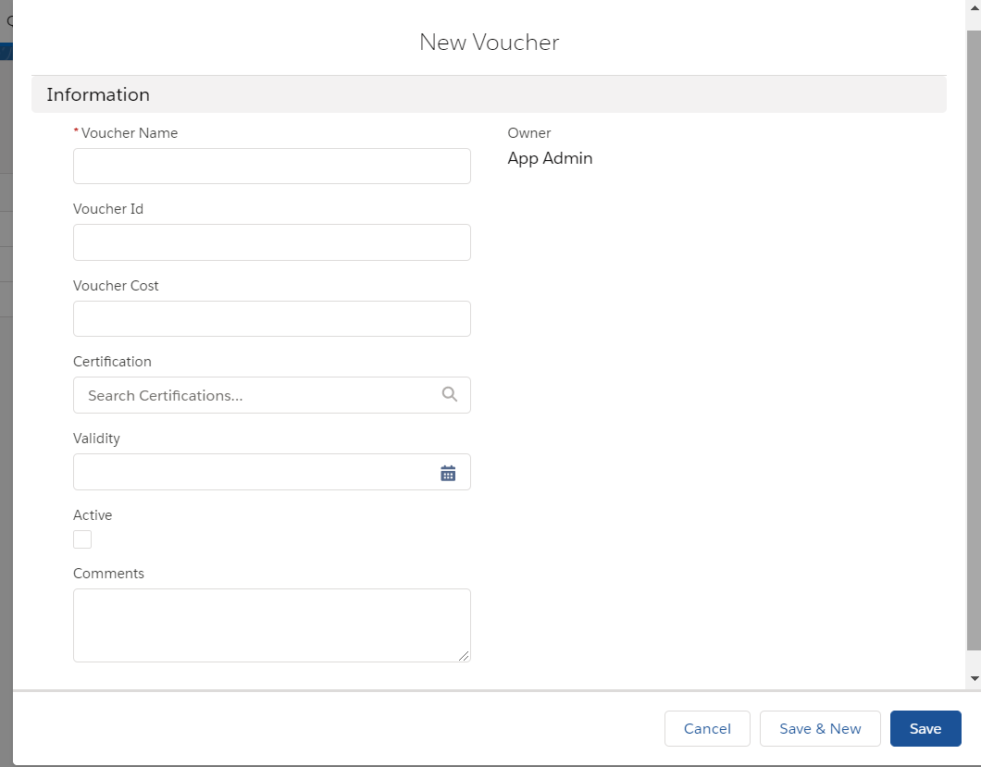
New Voucher fill out form:

Slide 21
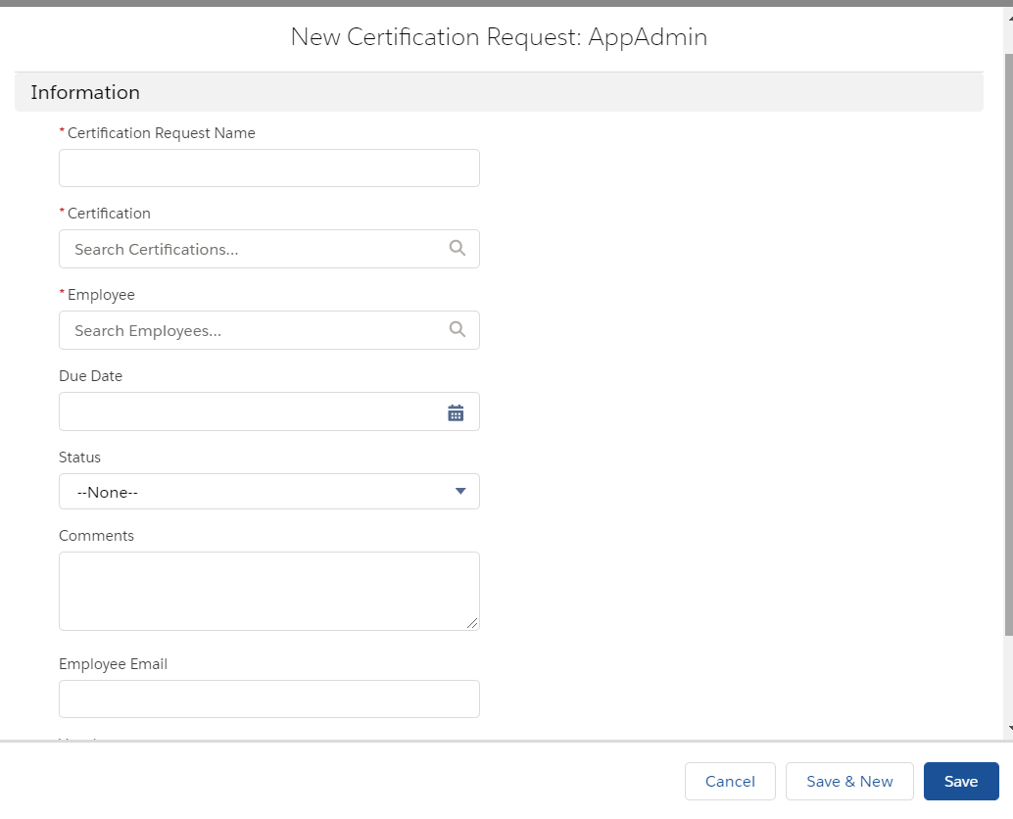
New Certification Request form:

Slide 22
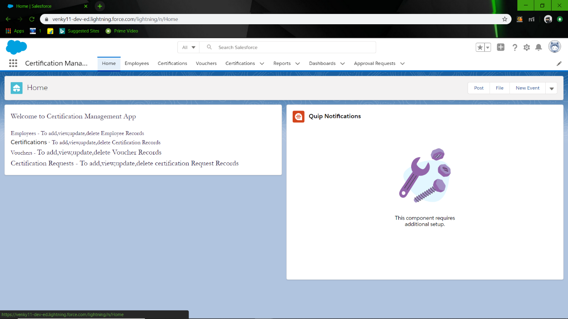
Certification Management System: Home Page

Slide 23
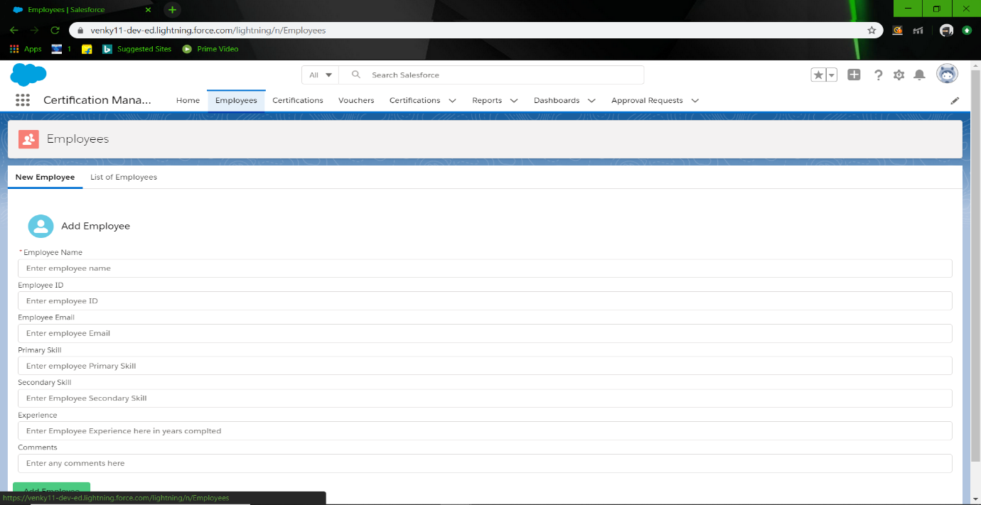
Add Employee

Slide 24
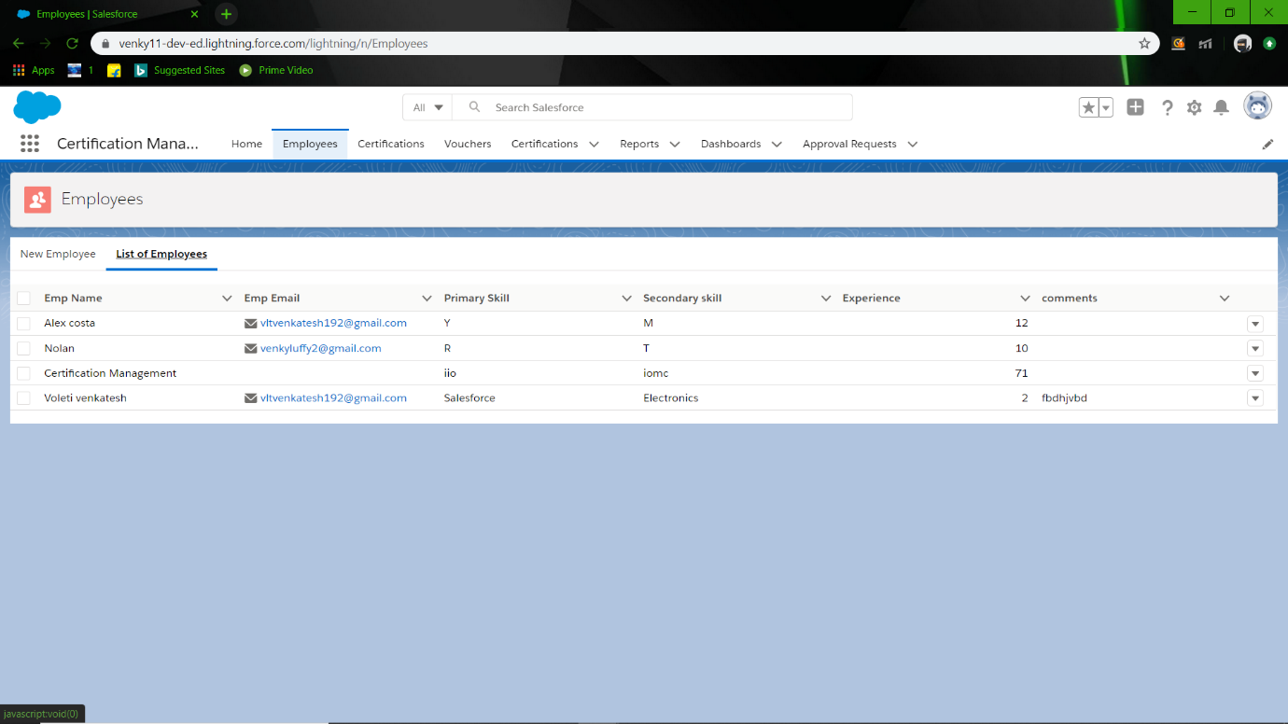
List of employees

Slide 25
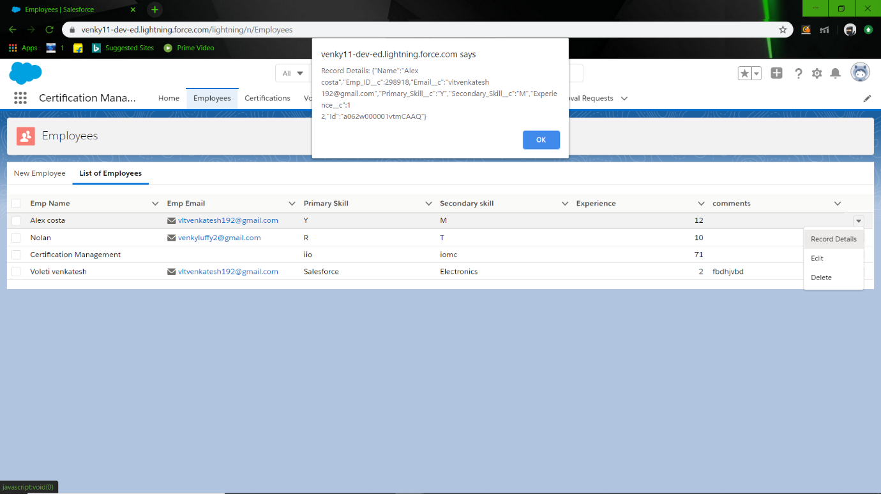
Record Details

Slide 26
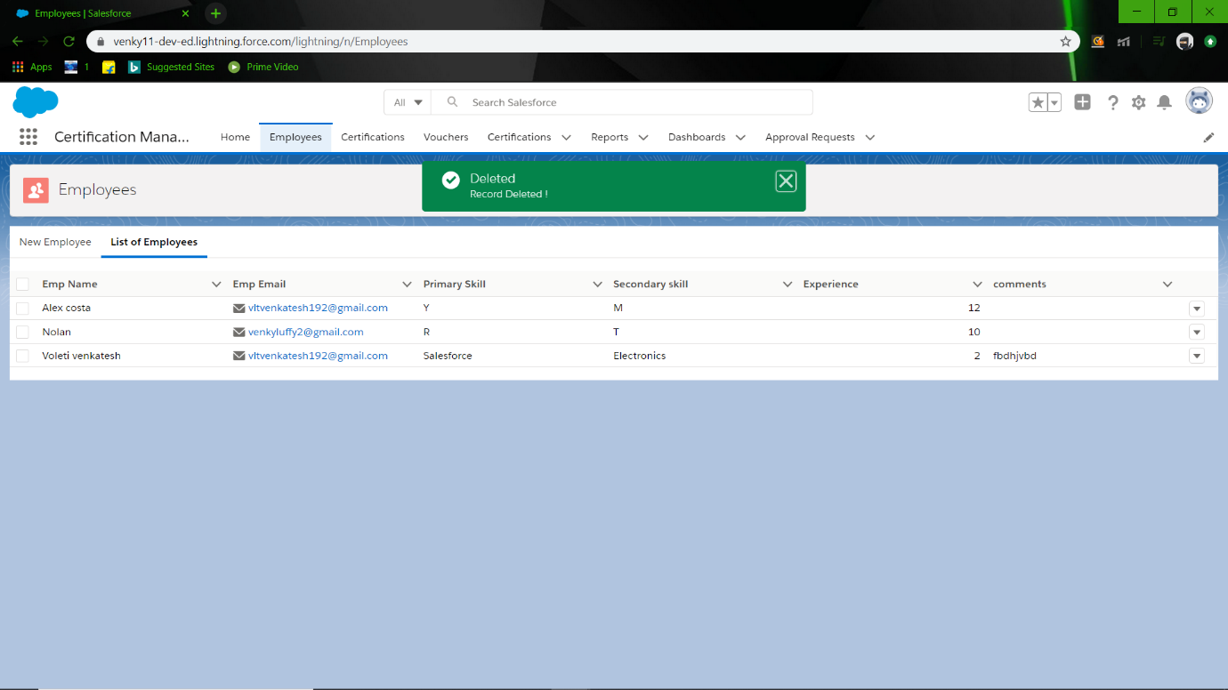
Delete Employee

Slide 27
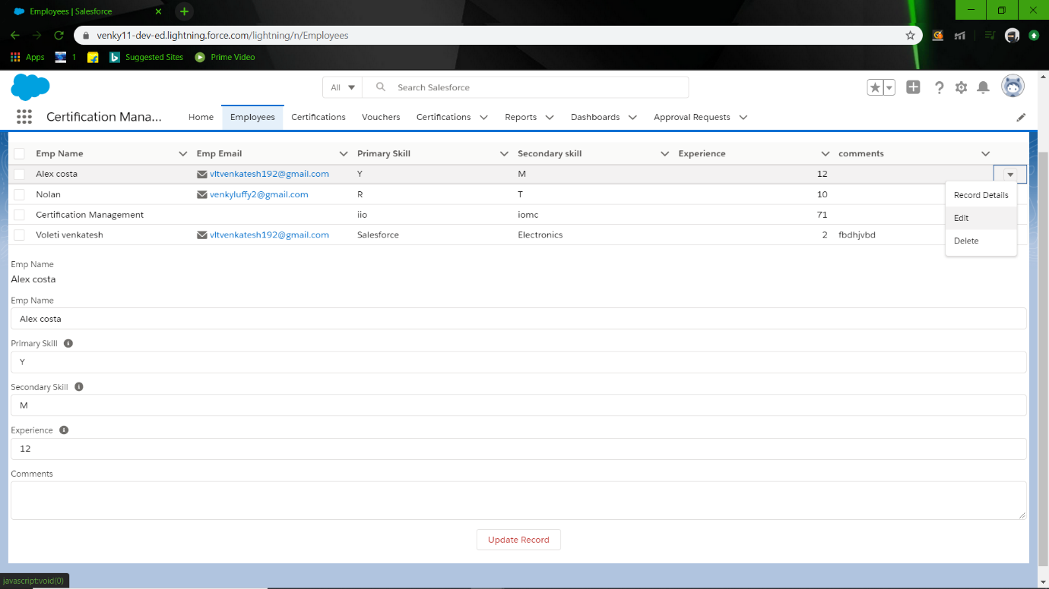
Update Employee

Slide 28
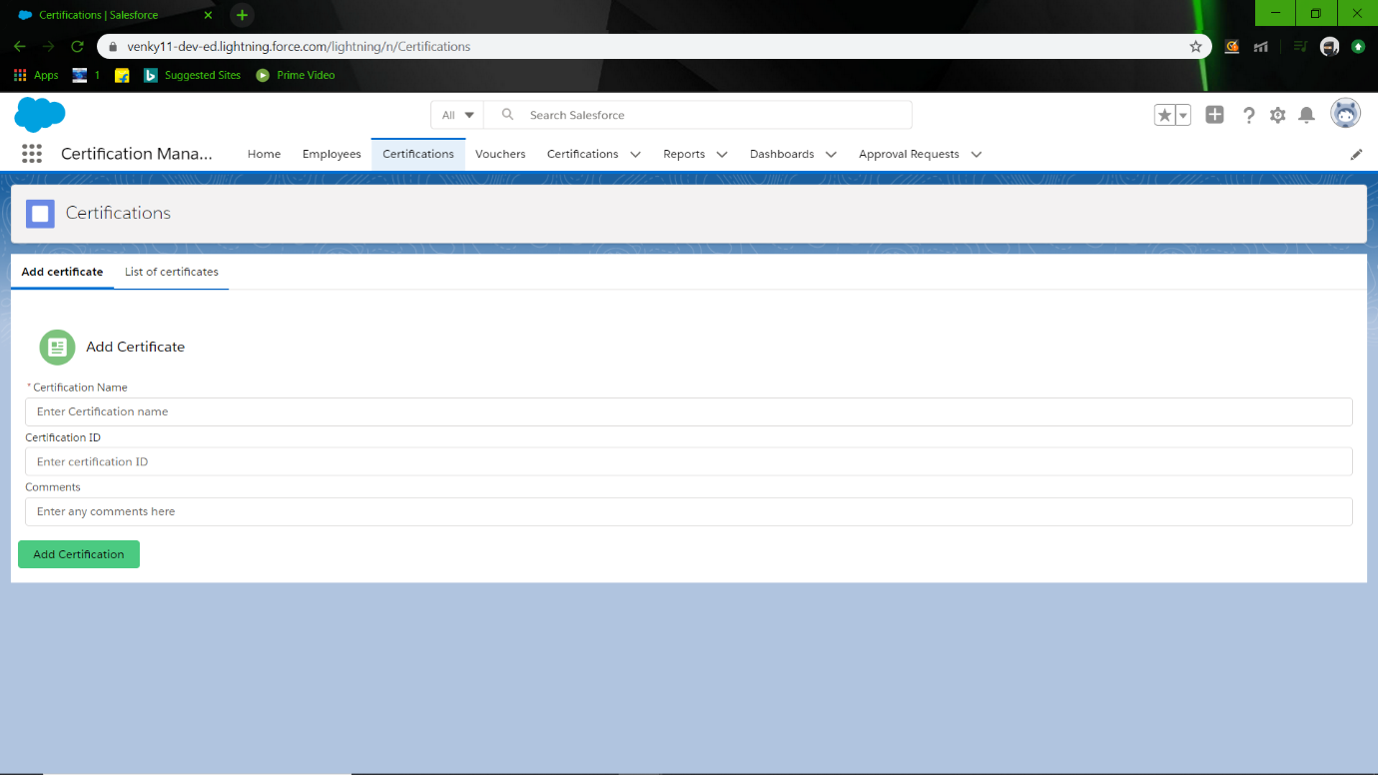
Add Certification

Slide 29
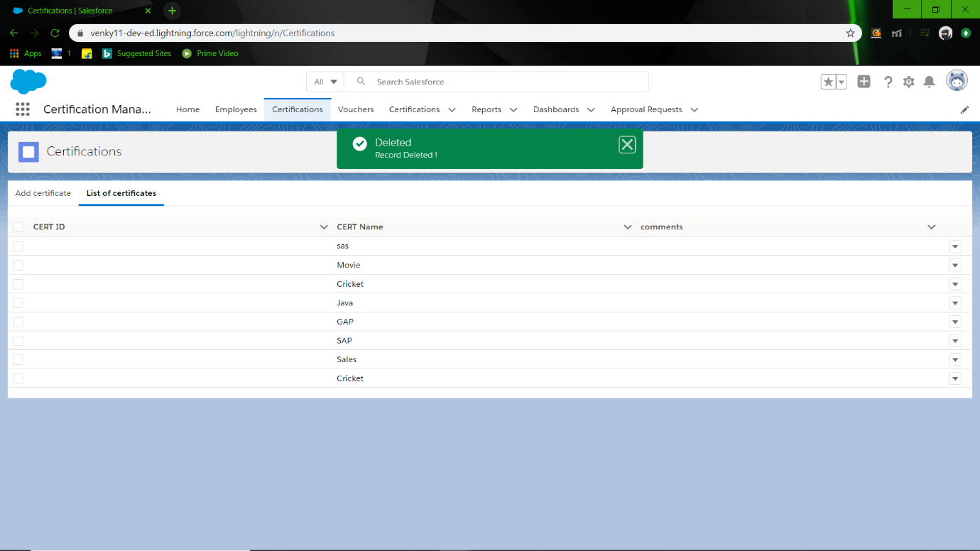
List of Certifications

Slide 30
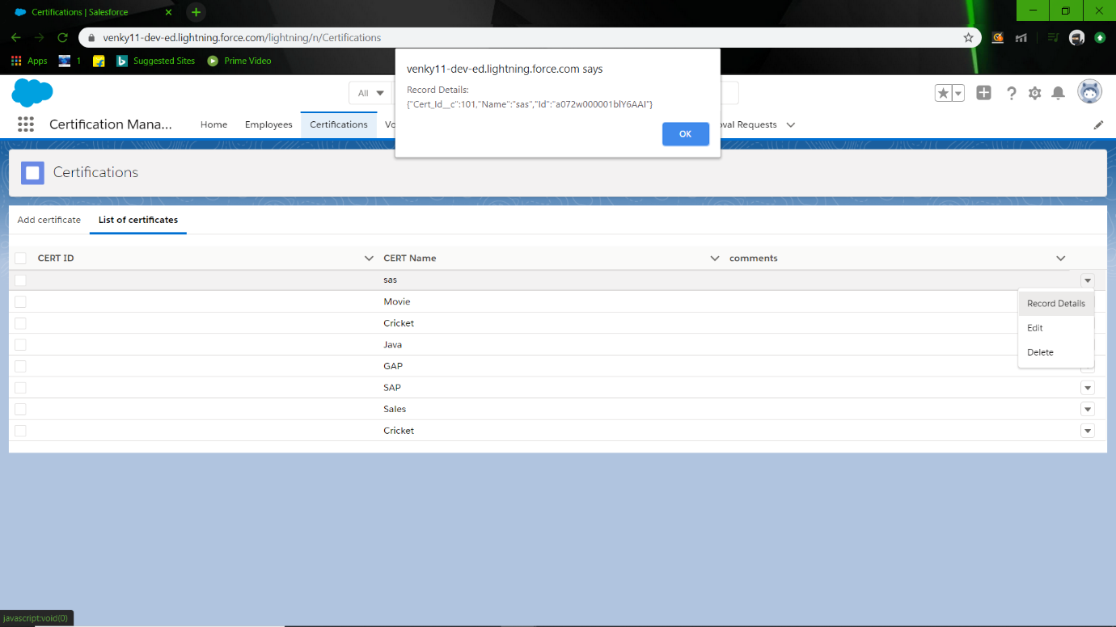
Certification Record Details

Slide 31
Delete Certification

Slide 32
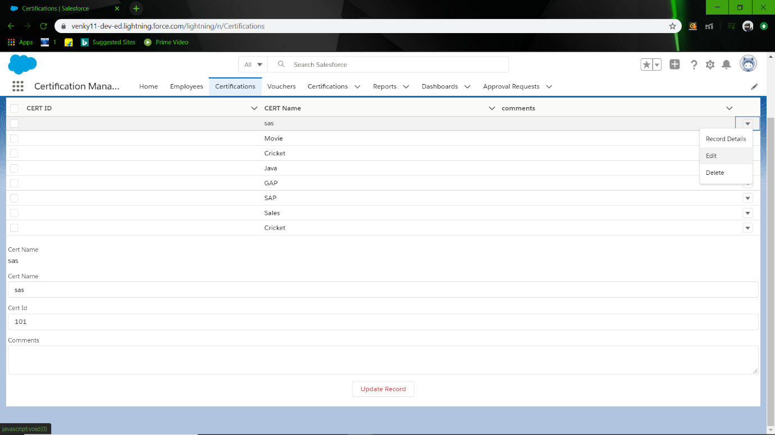
Update Certification

Slide 33
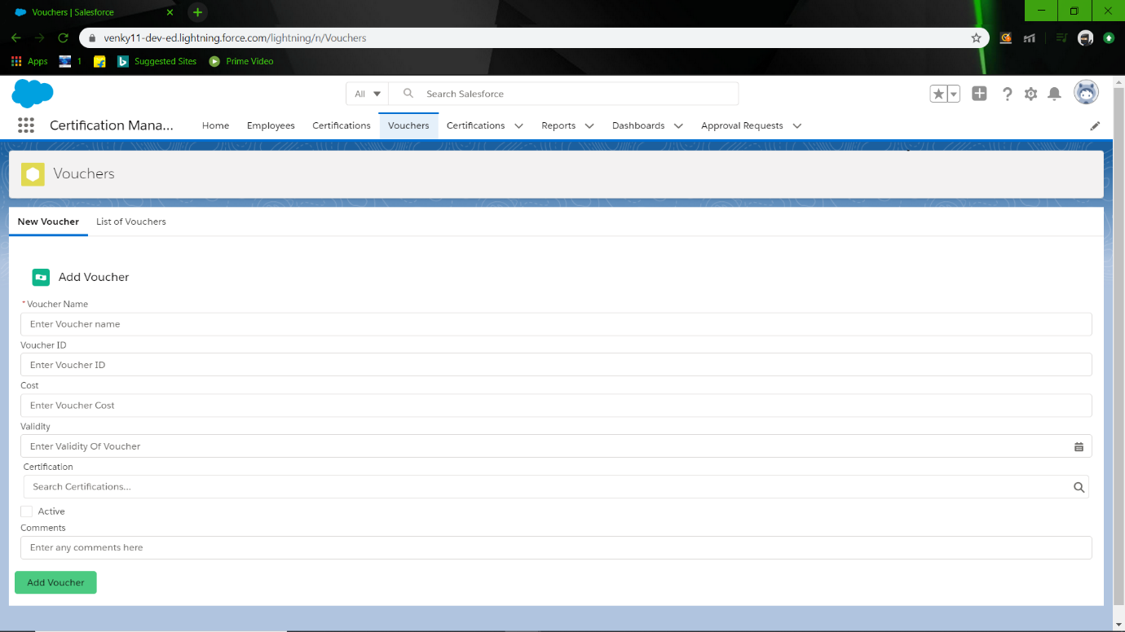
Add Vouchers

Slide 34
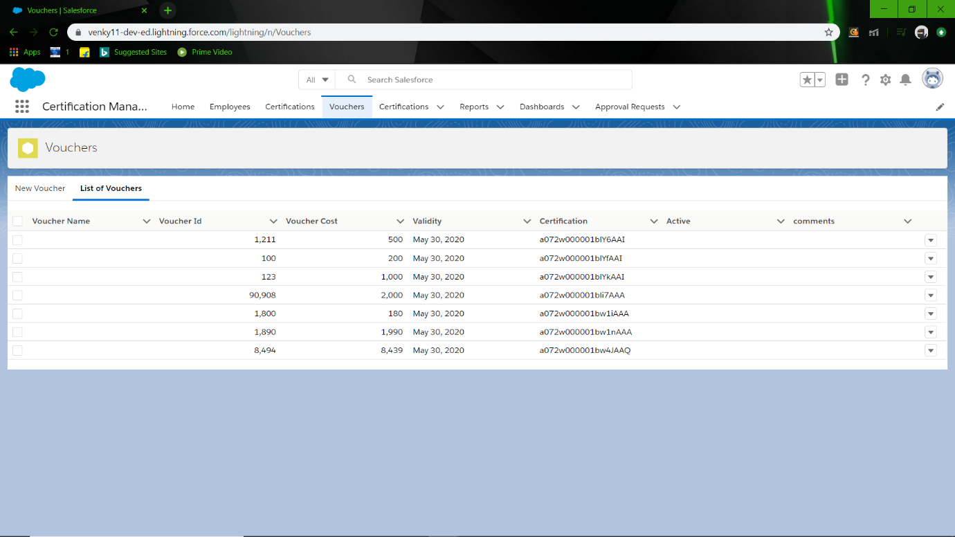
List of Voucher

Slide 35
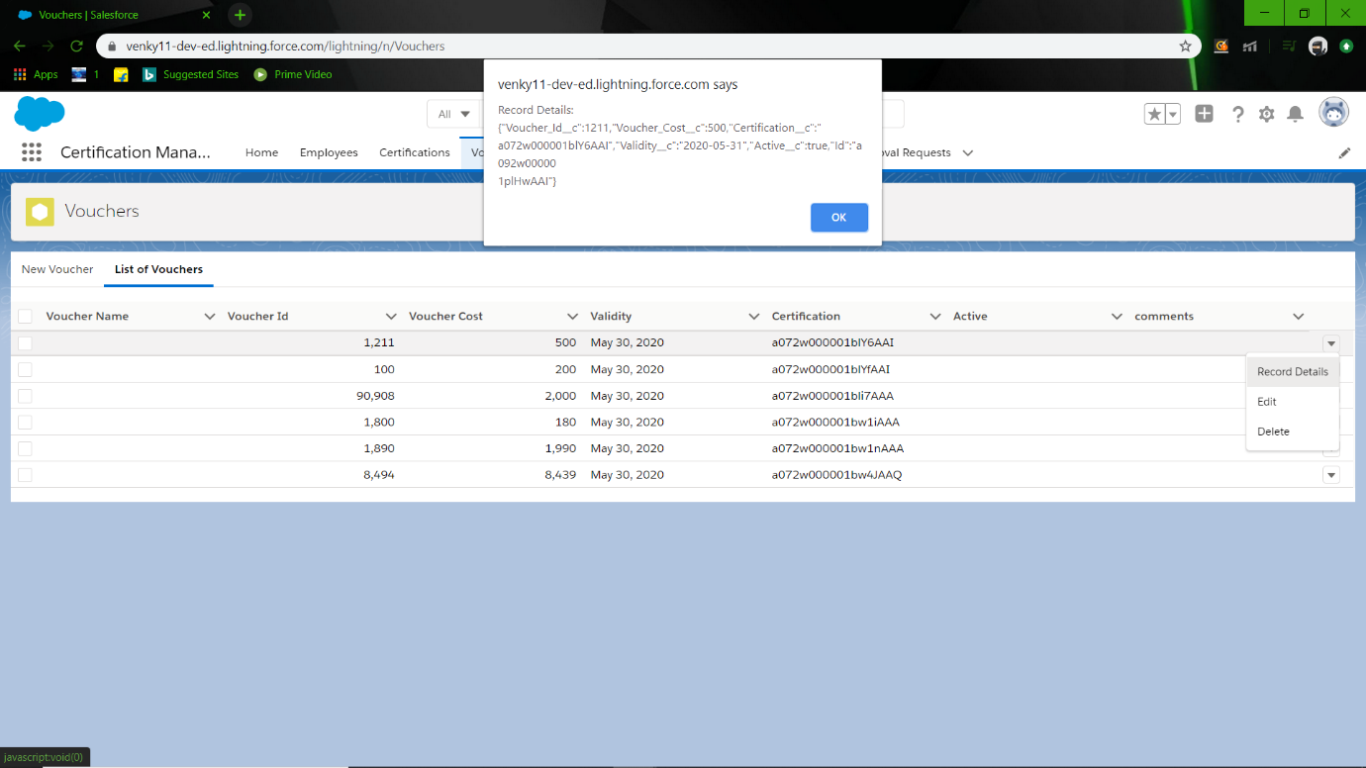
Voucher Record Detail

Slide 36
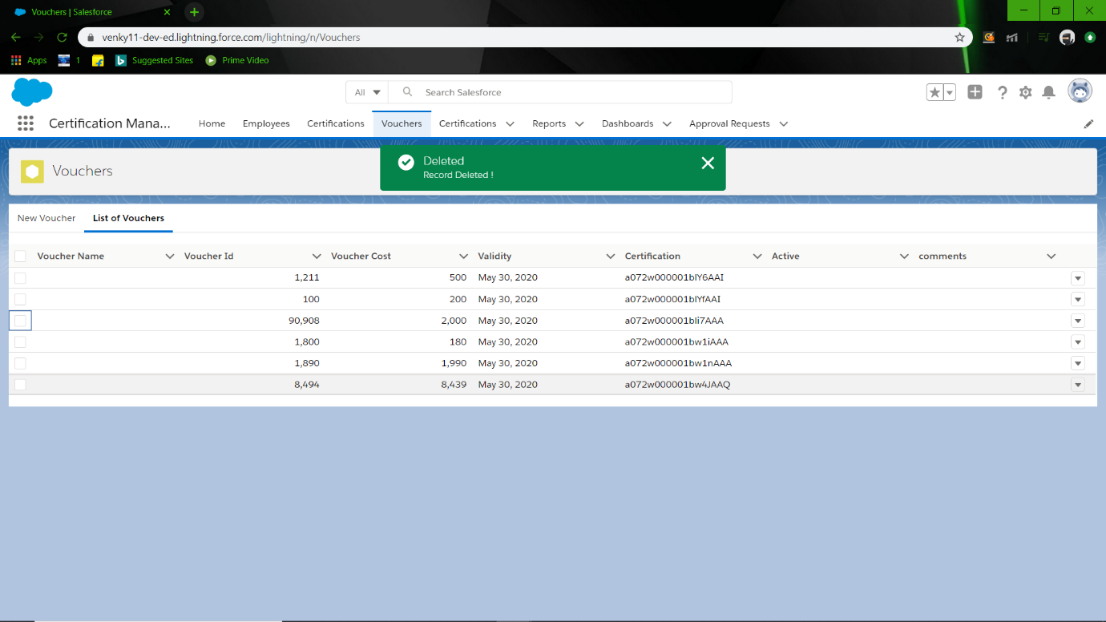
Delete Voucher:

Slide 37
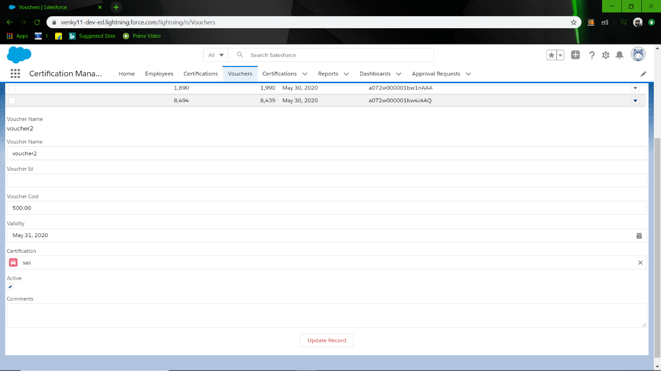
Edit Voucher

Slide 38
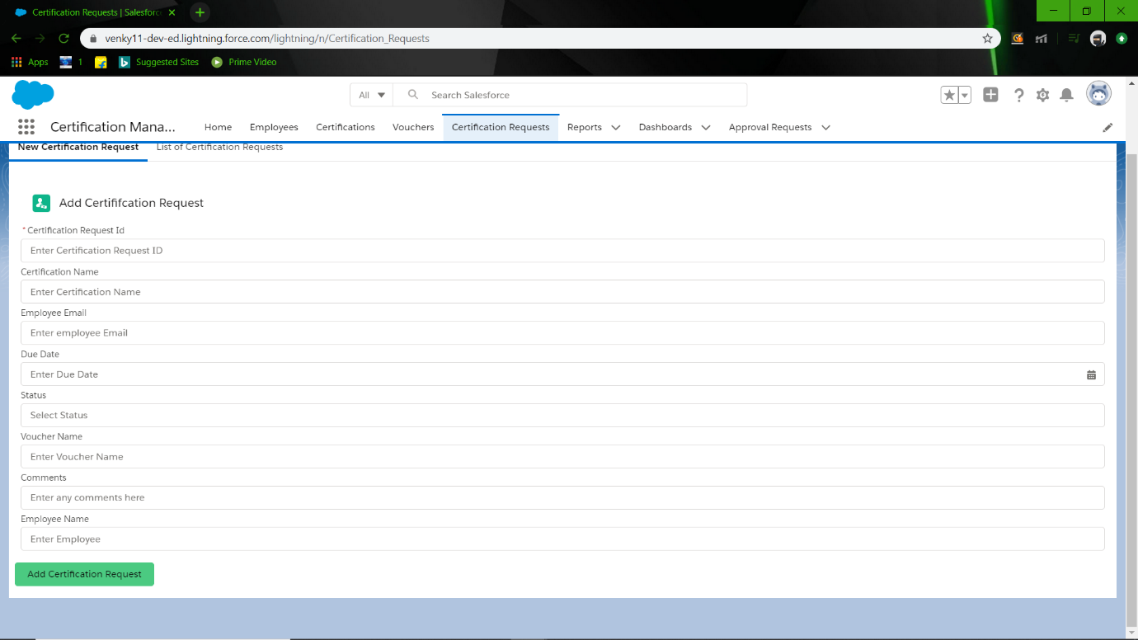
Add Certification request

Slide 39
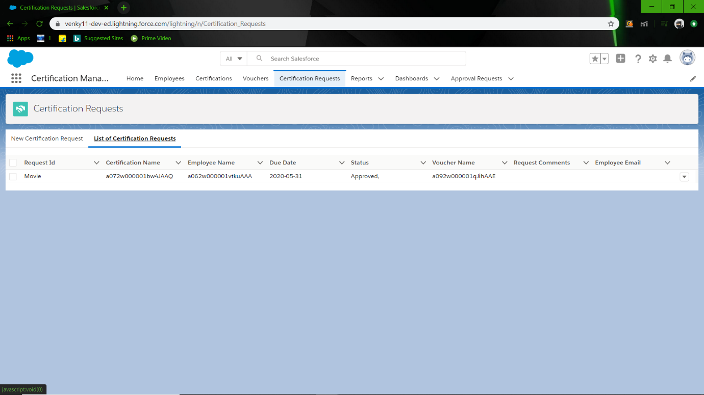
List of Certification request

Slide 40
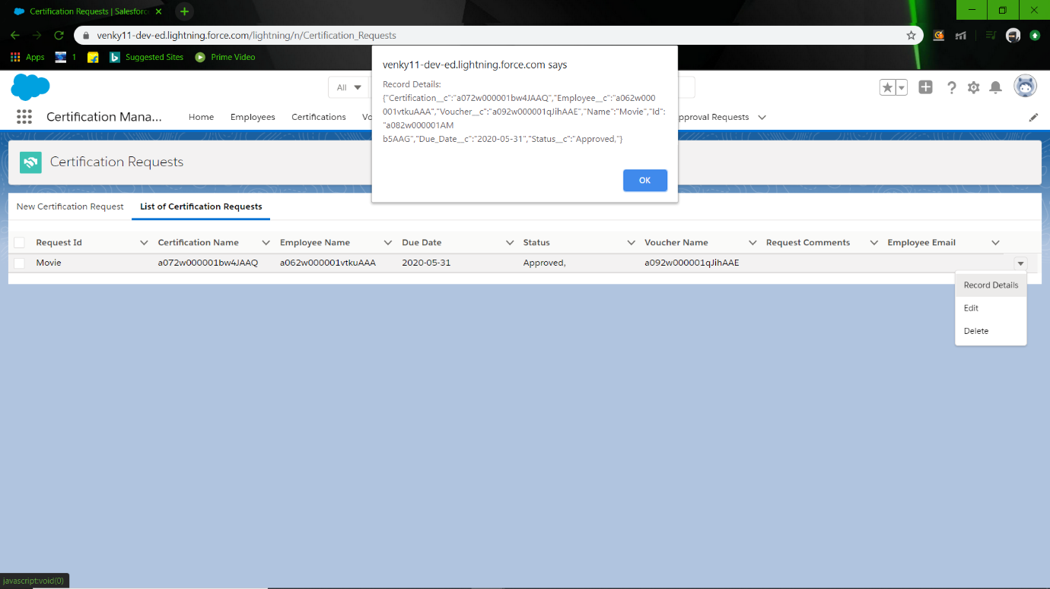
Certification request Record Details

Slide 41
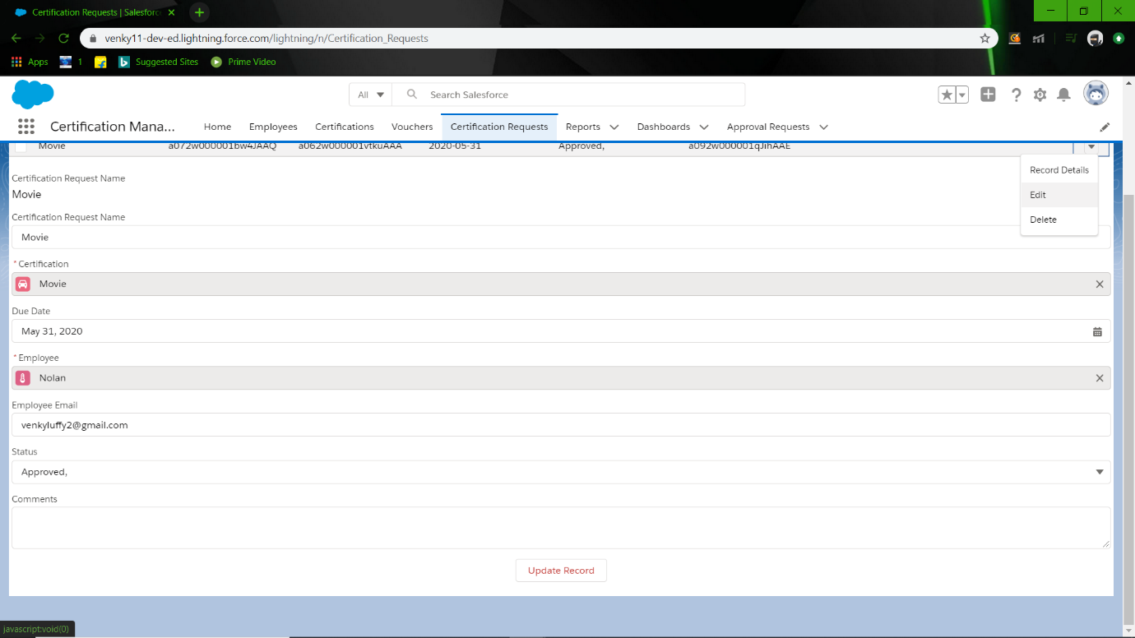
Update Certification request

Slide 42
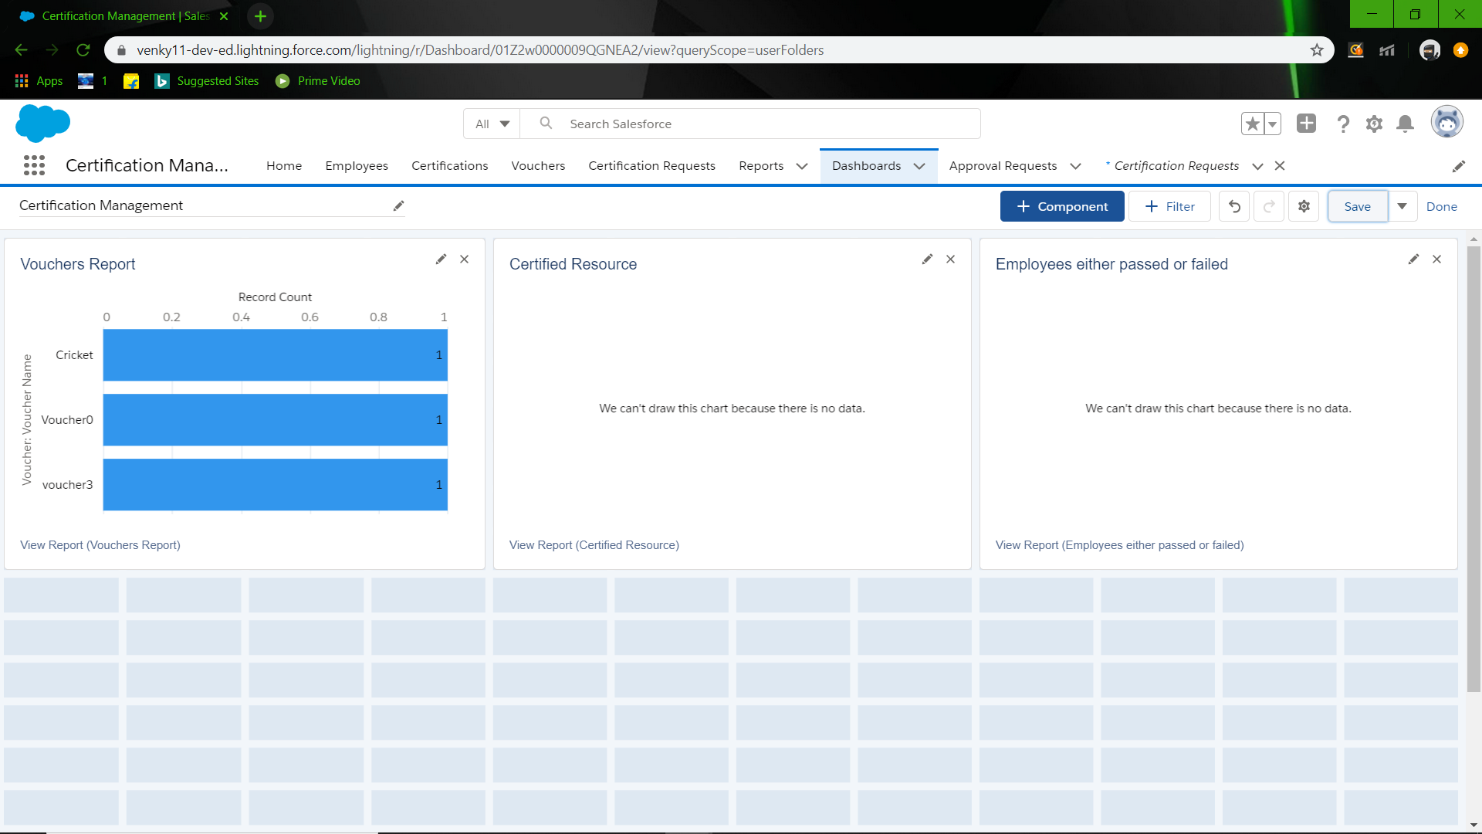
Dashboards

Slide 43
Result:
So, with this I conclude that Certification management App works as mentioned above and includes all use cases mentioned in Problem statement.

